Slide 1

State Tables and Graphs
ECE 2372 | Modern Digital System Design | Texas Tech University

Slide 2
Lecture Overview
Transition Tables
State Tables
State Graphs

Slide 3
Transition Tables
State Tables and Graphs | Modern Digital System Design

Slide 4
Transition Tables
Signal tracing and timing charts are fine for analyzing small sequential circuits.
To analyze larger and more complex sequential circuits, we need a more systematic approach.

Slide 5
Transition Tables
A transition table specifies the next state of a sequential circuit in terms of its present state and inputs.

Slide 6
Transition Tables
Determine the flip-flop input equations and the output equations from the circuit.
Derive the next-state equation for each flip-flop from its input equation.
Plot a next-state map for each flip-flop.
Combine these maps to form the transition table.

Slide 7
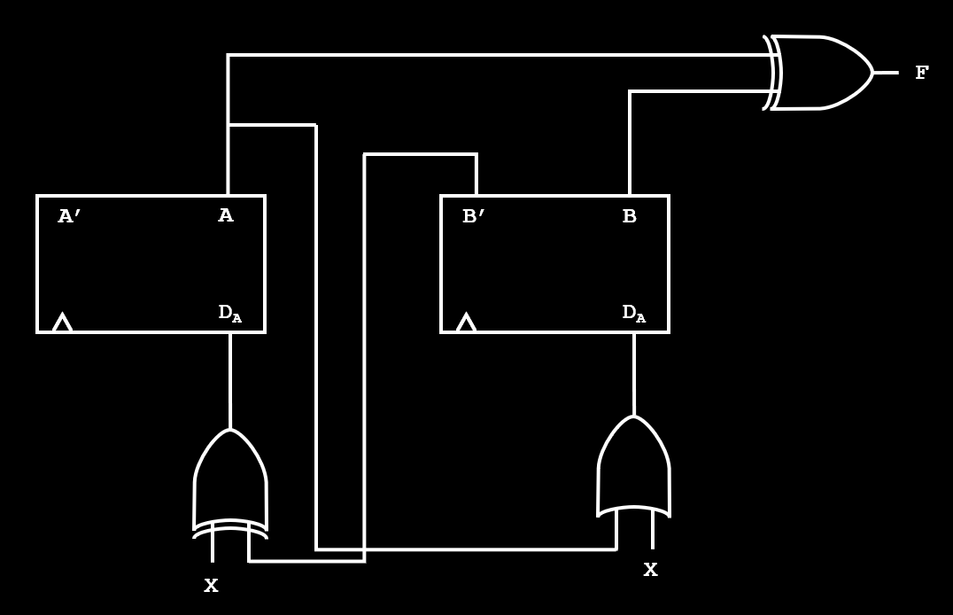
Transition Tables | Example

Slide 8



1. Determine the Flip-Flop Equations
$$D_{A}=X ⨁ B′$$
$$D_{B}=X+A$$
$$F=A⊕B$$

Slide 9





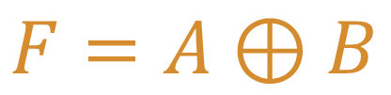
2. Derive the Next-State Equations
D Flip-Flop Next-State Equation:
$$Q^{+}=D$$
$$D_{A}=X ⨁ B′$$
$$D_{B}=X+A$$
$$A^{+}=D_{A}=X ⊕ B′$$
$$F=A⊕B$$
$$B^{+}=D_{B}=X+A$$

Slide 10
3. Plot the NS equations on a Map
A’
AB
A’
A
X
X’
1
0
0
1
0
1
3
2
X
0
1
1
0
4
5
7
6
B’
B
B’

Slide 11
3. Plot the NS equations on a Map
B’
AB
A’
A
X
X’
0
0
1
1
0
1
3
2
X
1
1
1
1
4
5
7
6
B’
B
B’

Slide 12
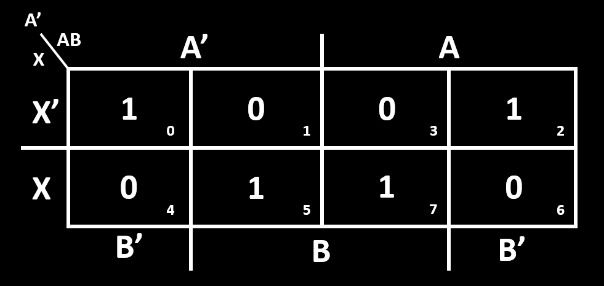
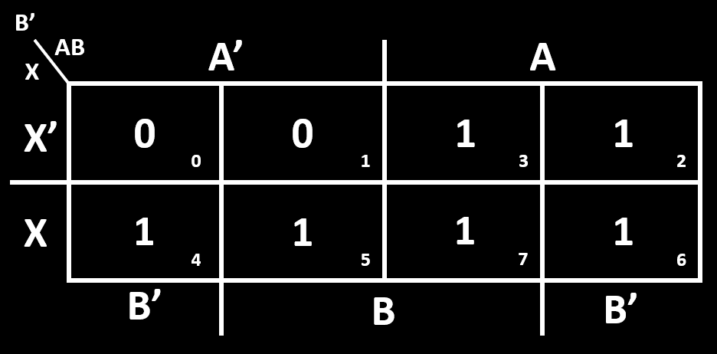
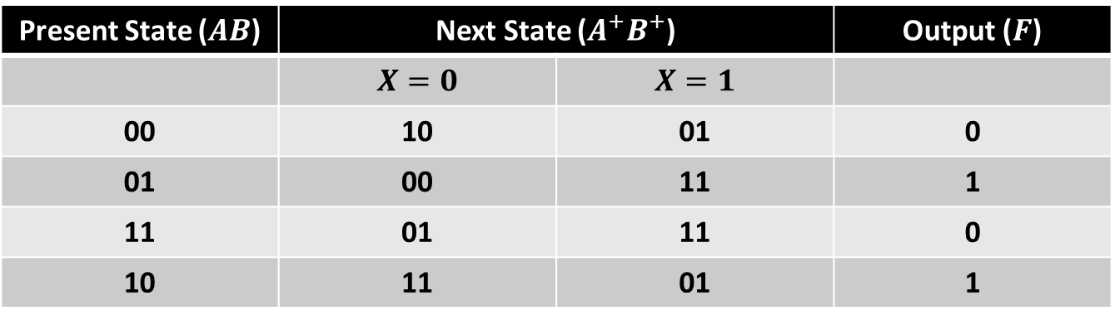
4. Combine the Maps onto a Transition Table
Present State ($AB$) | Next State ($A^{+}B^{+}$) |  | Output ($F$)
 | $$X=0$$ | $$X=1$$
00 | 10 | 01 | 0
01 | 00 | 11 | 1
11 | 01 | 11 | 0
10 | 11 | 01 | 1

Slide 13

What questions do you have?

Slide 14
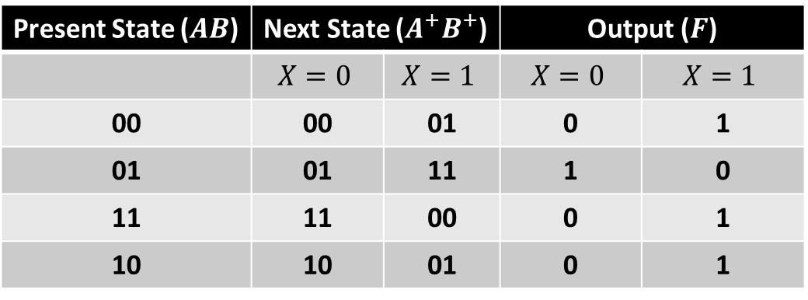

EXAM Question: Transition Tables
For the given transition table, what is the Boolean equation for the output signal?
$XB+XAB′+X^{′}A^{′}B′$
$XAB+X^{′}A^{′}+X^{′}A^{′}B′$
$XA+XA′B+X^{′}A^{′}B′$
$XA+X^{′}A^{′}B+XA^{′}B′$
Present State ($AB$) | Next State ($A^{+}B^{+}$) |  | Output ($F$)
 | $$X=0$$ | $$X=1$$ | $$X=0$$ | $$X=1$$
00 | 00 | 01 | 0 | 1
01 | 01 | 11 | 1 | 0
11 | 11 | 00 | 0 | 1
10 | 10 | 01 | 0 | 1

Slide 15
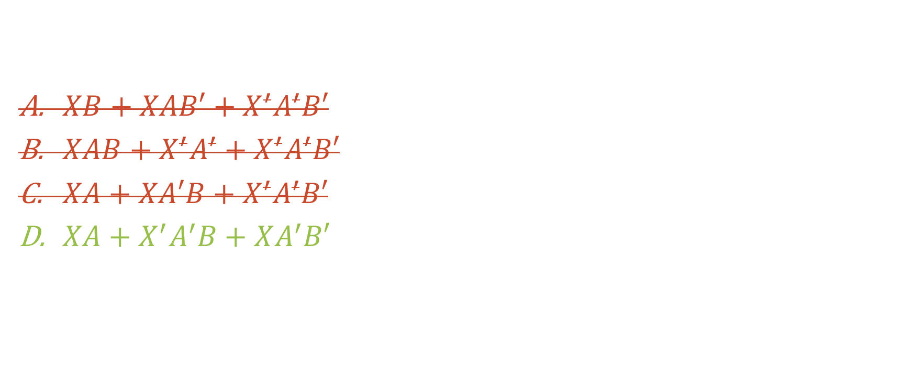
EXAM Question: Transition Tables
For the given transition table, what is the Boolean equation for the output signal?
$XB+XAB′+X^{′}A^{′}B′$
$XAB+X^{′}A^{′}+X^{′}A^{′}B′$
$XA+XA′B+X^{′}A^{′}B′$
$XA+X^{′}A^{′}B+XA^{′}B′$
Present State ($AB$) | Next State ($A^{+}B^{+}$) |  | Output ($F$)
 | $$X=0$$ | $$X=1$$ | $$X=0$$ | $$X=1$$
00 | 00 | 01 | 0 | 1
01 | 01 | 11 | 1 | 0
11 | 11 | 00 | 0 | 1
10 | 10 | 01 | 0 | 1

Slide 16
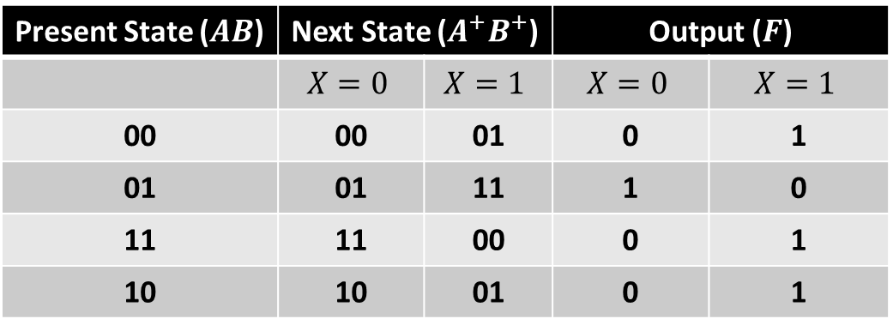
F’
AB
A’
A
X
X’
0
1
0
0
0
1
3
2
X
1
0
1
1
4
5
7
6
B’
B
B’
Present State ($AB$) | Next State ($A^{+}B^{+}$) |  | Output ($F$)
 | $$X=0$$ | $$X=1$$ | $$X=0$$ | $$X=1$$
00 | 00 | 01 | 0 | 1
01 | 01 | 11 | 1 | 0
11 | 11 | 00 | 0 | 1
10 | 10 | 01 | 0 | 1

Slide 17
F’
AB
A’
A
X
X’
0
1
0
0
0
1
3
2
X
1
0
1
1
4
5
7
6
B’
B
B’

Slide 18

F’
AB
A’
A
X
X’
0
1
0
0
0
1
3
2
X
1
0
1
1
4
5
7
6
B’
B
B’
$$F\left(X, A, B\right)=XA$$

Slide 19

F’
AB
A’
A
X
X’
0
1
0
0
0
1
3
2
X
1
0
1
1
4
5
7
6
B’
B
B’
$$F\left(X, A, B\right)=XA+X^{′}A^{′}B$$

Slide 20
F’
AB
A’
A
X
X’
0
1
0
0
0
1
3
2
X
1
0
1
1
4
5
7
6
B’
B
B’
$F\left(X, A, B\right)=XA+X^{′}A^{′}B+XA^{′}B′$

Slide 21
State Tables
State Tables and Graphs | Modern Digital System Design

Slide 22
State Tables
A state table is an alternate form of a transition table in which the states are represented symbolically.

Slide 23
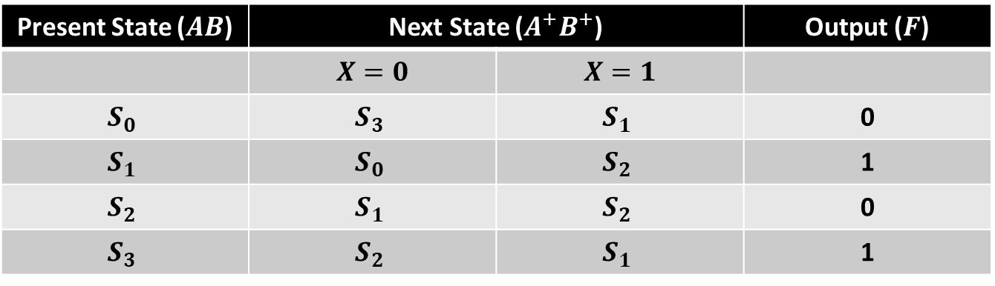
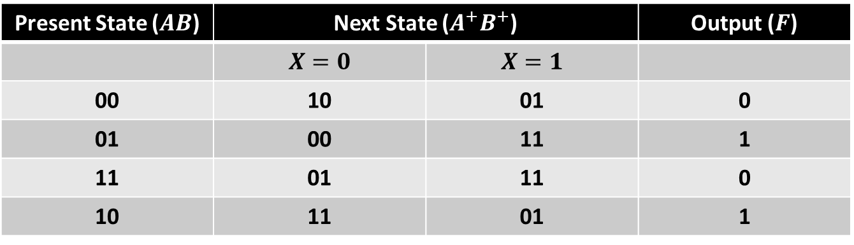
Transition Table
Present State ($AB$) | Next State ($A^{+}B^{+}$) |  | Output ($F$)
 | $$X=0$$ | $$X=1$$
00 | 10 | 01 | 0
01 | 00 | 11 | 1
11 | 01 | 11 | 0
10 | 11 | 01 | 1
State Table
Present State ($AB$) | Next State ($A^{+}B^{+}$) |  | Output ($F$)
 | $$X=0$$ | $$X=1$$
$$S_{0}$$ | $$S_{3}$$ | $$S_{1}$$ | 0
$$S_{1}$$ | $$S_{0}$$ | $$S_{2}$$ | 1
$$S_{2}$$ | $$S_{1}$$ | $$S_{2}$$ | 0
$$S_{3}$$ | $$S_{2}$$ | $$S_{1}$$ | 1

Slide 24
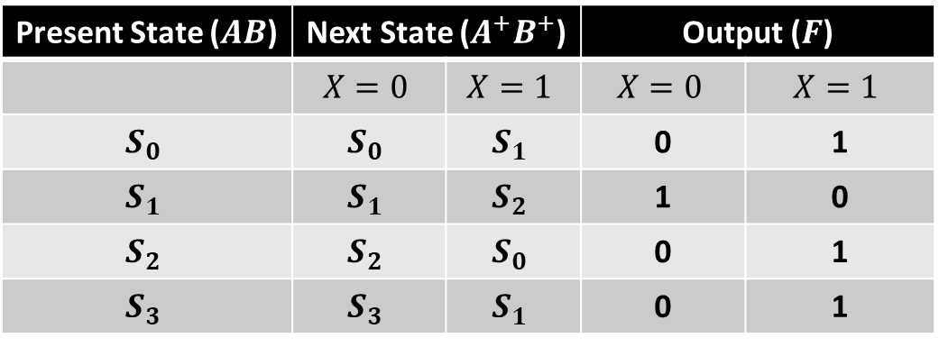
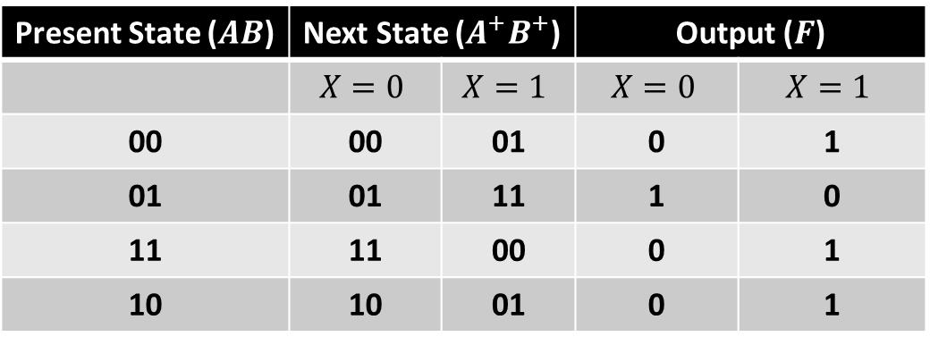
Transition Table
Present State ($AB$) | Next State ($A^{+}B^{+}$) |  | Output ($F$)
 | $$X=0$$ | $$X=1$$ | $$X=0$$ | $$X=1$$
00 | 00 | 01 | 0 | 1
01 | 01 | 11 | 1 | 0
11 | 11 | 00 | 0 | 1
10 | 10 | 01 | 0 | 1
State Table
Present State ($AB$) | Next State ($A^{+}B^{+}$) |  | Output ($F$)
 | $$X=0$$ | $$X=1$$ | $$X=0$$ | $$X=1$$
$$S_{0}$$ | $$S_{0}$$ | $$S_{1}$$ | 0 | 1
$$S_{1}$$ | $$S_{1}$$ | $$S_{2}$$ | 1 | 0
$$S_{2}$$ | $$S_{2}$$ | $$S_{0}$$ | 0 | 1
$$S_{3}$$ | $$S_{3}$$ | $$S_{1}$$ | 0 | 1

Slide 25

What questions do you have?

Slide 26
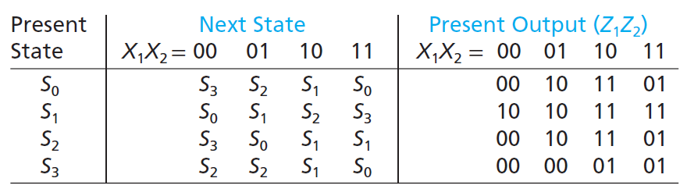

EXAM QUESTION: State Tables
For the given state table, what will be the next-state and output if the present-state is $S_{3}$ and the input is $X_{1}X_{2}=11$?
$S_{0}, Z_{1}Z_{2}=01$
$S_{2}, Z_{1}Z_{2}=00$
$S_{1}, Z_{1}Z_{2}=01$
$S_{0}, Z_{1}Z_{2}=10$

Slide 27
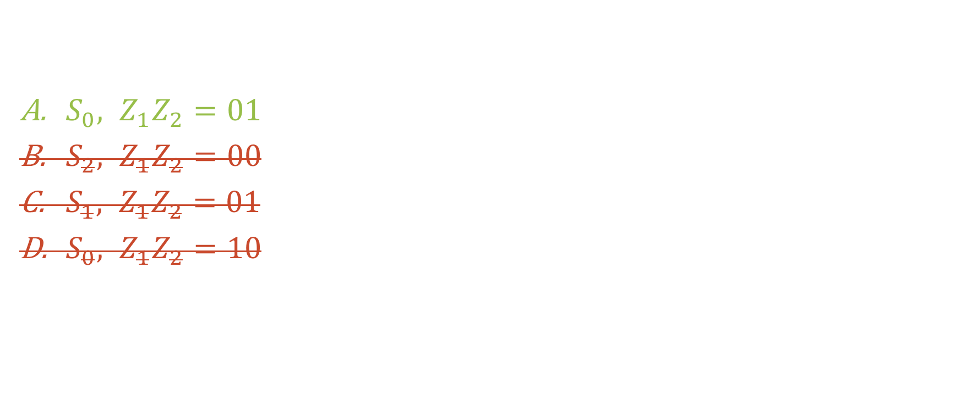
EXAM QUESTION: State Tables
For the given state table, what will be the next-state and output if the present-state is $S_{3}$ and the input is $X_{1}X_{2}=11$?
$S_{0}, Z_{1}Z_{2}=01$
$S_{2}, Z_{1}Z_{2}=00$
$S_{1}, Z_{1}Z_{2}=01$
$S_{0}, Z_{1}Z_{2}=10$

Slide 28
State Graphs
State Tables and Graphs | Modern Digital System Design

Slide 29
State Graphs
The state graph provides a more visual way of representing the behavior of the sequential circuit.
There are slightly different forms of the state graph, depending on whether the circuit is a Mealy or Moore Machine.

Slide 30






Moore State Graphs
$$X$$
$$S_{0}$$
$$S_{1}$$
$$F$$
$$F$$
$$X$$

Slide 31
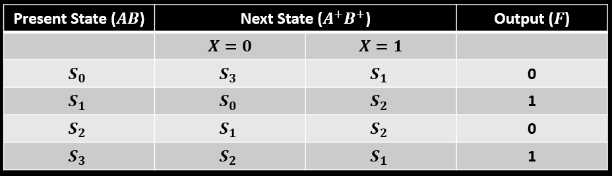








$$S_{0}$$
$$0$$
$$S_{3}$$
$$S_{1}$$
$$1$$
$$1$$
$$S_{2}$$
$$0$$

Slide 32


$$S_{0}$$
$$0$$
$$1$$
$$0$$
$$S_{3}$$
$$S_{1}$$
$$1$$
$$1$$
$$S_{2}$$
$$0$$

Slide 33




$$S_{0}$$
$$0$$
$$1$$
$$0$$
$$S_{3}$$
$$0$$
$$S_{1}$$
$$1$$
$$1$$
$$S_{2}$$
$$0$$
$$1$$

Slide 34




$$S_{0}$$
$$0$$
$$1$$
$$0$$
$$S_{3}$$
$$0$$
$$S_{1}$$
$$1$$
$$1$$
$$S_{2}$$
$$0$$
$$1$$
$$1$$
$$0$$

Slide 35




$$S_{0}$$
$$0$$
$$1$$
$$0$$
$$S_{3}$$
$$0$$
$$S_{1}$$
$$1$$
$$1$$
$$1$$
$$S_{2}$$
$$0$$
$$0$$
$$1$$
$$1$$
$$0$$

Slide 36




Mealy State Graphs
$$X/F$$
$$S_{0}$$
$$S_{1}$$
$$X/F$$

Slide 37
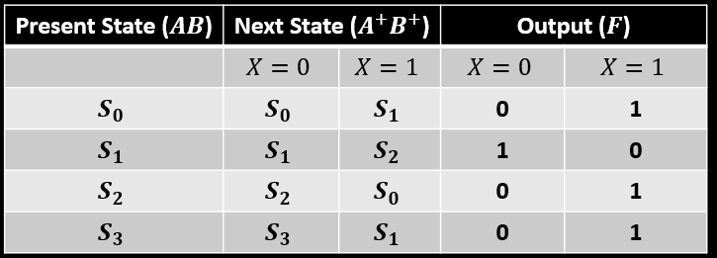




$$S_{0}$$
$$S_{3}$$
$$S_{2}$$
$$S_{1}$$

Slide 38
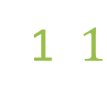

0$/0$
$$S_{0}$$
1$/1$
$$S_{3}$$
$$S_{2}$$
$$S_{1}$$

Slide 39


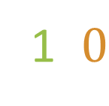
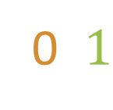
0$/0$
$$S_{0}$$
1$/1$
$$S_{3}$$
$$S_{2}$$
$$S_{1}$$
0$/1$
1$/0$

Slide 40
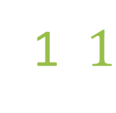



0$/0$
$$S_{0}$$
1$/1$
1$/1$
$$S_{3}$$
$$S_{2}$$
$$S_{1}$$
0$/0$
0$/1$
1$/0$

Slide 41




0$/0$
0$/0$
$$S_{0}$$
1$/1$
1$/1$
$$S_{3}$$
1$/1$
$$S_{2}$$
$$S_{1}$$
0$/0$
0$/1$
1$/0$

Slide 42


0$/0$
0$/0$
$$S_{0}$$
1$/1$
1$/1$
$$S_{3}$$
1$/1$
$$S_{2}$$
$$S_{1}$$
0$/0$
0$/1$
1$/0$

Slide 43
What questions do you have?

Slide 44
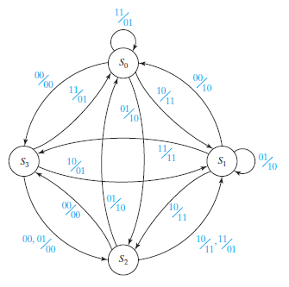

EXAM QUESTION: State Graphs
For the given state graph, what will the next-state and output if the present-state is $S_{2}$ and the input is $X_{1}X_{2}=10$?
$S_{2}, 11$
$S_{1}, 11$
$S_{3}, 00$
$S_{1}, 01$

Slide 45
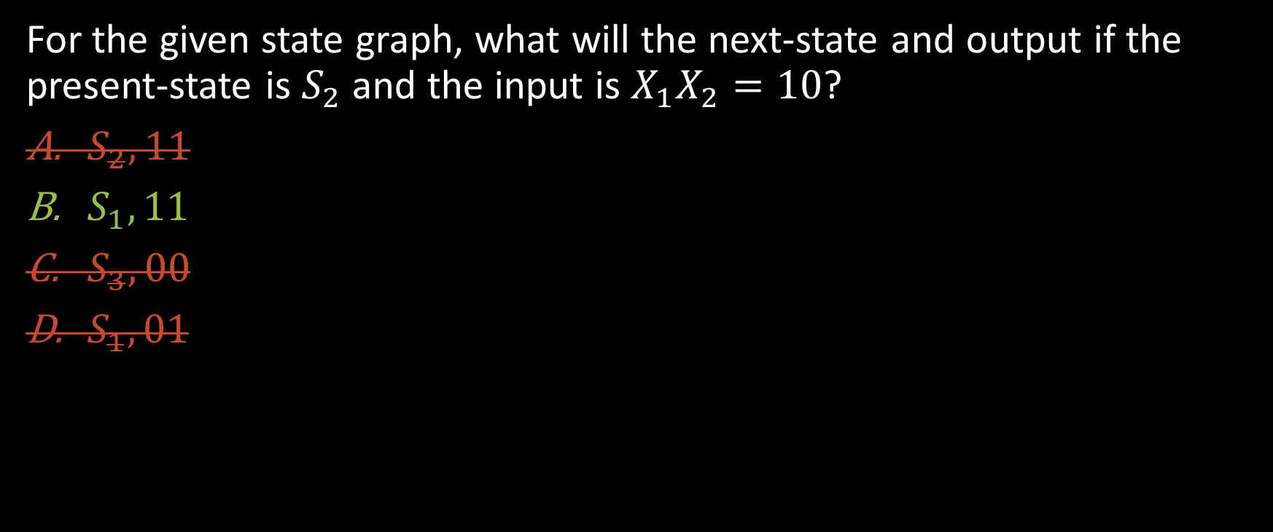
EXAM QUESTION: State Graphs
For the given state graph, what will the next-state and output if the present-state is $S_{2}$ and the input is $X_{1}X_{2}=10$?
$S_{2}, 11$
$S_{1}, 11$
$S_{3}, 00$
$S_{1}, 01$

Slide 46
Lecture Recap
Transition Tables
State Tables
State Graphs

Slide 47

What questions do you have?

Slide 48
State Tables and Graphs
ECE 2372 | Modern Digital System Design | Texas Tech University

